Slide 1
Unit 7: Cluster Analysis

Slide 2
Clustering
The process of grouping a set of physical or abstract objects into classes of similar objects is called clustering. It is an unsupervised learning technique.
A cluster is a collection of data objects that are similar to one another within the same cluster and are dissimilar to the objects in other clusters.
Clustering can also be used for outlier detection, where outliers may be more interesting than common cases.
Applications of outlier detection include the detection of credit card fraud and the monitoring of criminal activities in electronic commerce.
For example, exceptional cases in credit card transactions, such as very expensive and frequent purchases, may be of interest as possible fraudulent activity.

Slide 3
Similarity and Dissimilarity
Distance measures are used in order to find similarity or dissimilarity between data objects.
The most popular distance measure is Euclidean distance, which is defined as:
Where,
Another well-known metric is Manhattan (or city block) distance, defined as

Slide 4
Similarity and Dissimilarity
Minkowski distance is a generalization of both Euclidean distance and Manhattan distance. It is defined as
Where p is a positive integer, such a distance is also called L_{p} norm, in some literature. It represents the Manhattan distance when p = 1 (i.e., L₁ norm) and Euclidean distance when p = 2 (i.e., L₂ norm).

Slide 5
Categories of Clustering Algorithms
Many clustering algorithms exist in the literature. In general, the major clustering methods can be classified into the following categories.
Partitioning Methods
Given a database of n objects or data tuples, a partitioning method constructs k partitions of the data, where each partition represents a cluster and k <n.
Given k, the number of partitions to construct, a partitioning method creates an initial partitioning. It then uses an iterative relocation technique that attempts to improve the partitioning by moving objects from one group to another.

Slide 6
Categories of Clustering Algorithms
Hierarchical Methods
A hierarchical method creates a hierarchical decomposition of the given set of data objects. A hierarchical method can be classified as being either agglomerative or divisive.
The agglomerative approach follows the bottom-up approach. It starts with each object forming a separate group. It successively merges the objects or groups that are close to one another, until a termination condition holds.
The divisive approach follows the top-down approach. It starts with all of the objects in the same cluster. In each successive iteration, a cluster is split up into smaller clusters, until a termination condition holds.

Slide 7
Categories of Clustering Algorithms
Density-based Methods
Most partitioning methods cluster objects based on the distance between objects. Such methods can find only spherical-shaped clusters and encounter difficulty at discovering clusters of arbitrary shapes.
Other clustering methods have been developed based on the notion of density. Their general idea is to continue growing the given cluster as long as the density (number of objects or data points) in the neighborhood exceeds some threshold.

Slide 8
Categories of Clustering Algorithms
Model-based Methods
Model-based methods hypothesize a model for each of the clusters and find the best fit of the data to the given model.
EM is an algorithm that performs expectation-maximization analysis based on statistical modeling.

Slide 9
K-Means Algorithm
K-means is one of the simplest partitioning based clustering algorithm. The procedure follows a simple and easy way to classify a given data set into a certain number of clusters (assume k clusters) fixed Apriori.
The main idea is to define k centers, one for each cluster. These centers should be selected cleverly because of different location causes different result. So, the better choice is to place them as much as possible far away from each other.

Slide 10
K-Means Algorithm
Initialize cluster centroids μ₁, μ₂, . . . , μ_{k} belonging to data points randomly.
Repeat Until Convergence
{
For every i, set
for every j, set
}

Slide 11
K-Means Algorithm
Example: Divide the data points {(2,10), ((2,5), (8,4), (5,8), (7,5), (6,4)} into two clusters.
Solution
Let p1=(2,10) p2=(2,5) p3=(8,4) p4=(5,8) p5=(7,5) p6=(6,4)
Initial step
Choose Cluster centers randomly
Let μ₁ =(2,5) and μ₂ =(6,4) are two initial cluster centers.

Slide 12
K-Means Algorithm
Iteration 1: Calculate distance between clusters centers and each data points
d(μ₁,p₁)=5 d(μ₂,p₁)=7.21
d(μ₁,p₂)=0 d(μ₂,p₂)=4.12
d(μ₁,p₃)=6.08 d(μ₂,p₃)=2
d(μ₁,p₄)=4.24 d(μ₂,p₄)=4.12
d(μ₁,p₅)=5 d(μ₂,p₅)=1.41
d(μ₁,p₆)=4.12 d(μ₂,p₆)=0
Thus, Cluster1={p1,p2} cluster2={p3,p4,p5,p6}

Slide 13
K-Means Algorithm
Iteration 2: New Cluster centers: μ₁ =(2,7.5) μ₂ =(6.5,5.25)
d(μ₁,p₁)=2.5 d(μ₂,p₁)=6.54
d(μ₁,p₂)=2.5 d(μ₂,p₂)=4.51
d(μ₁,p₃)=6.95 d(μ₂,p₃)=1.95
d(μ₁,p₄)=3.04 d(μ₂,p₄)=3.13
d(μ₁,p₅)=4.59 d(μ₂,p₅)= 0.56
d(μ₁,p₆)= 5.32 d(μ₂,p₆)=1.35
Thus, Cluster1={p1,p2,p4} cluster2={p3,p5,p6}

Slide 14
K-Means Algorithm
Iteration 3: New Cluster centers: μ₁ = (3,7.67) μ₂ ==(7,4.33)
d(μ₁,p₁)=2.54 d(μ₂,p₁)=7.56
d(μ₁,p₂)=2.85 d(μ₂,p₂)=5.04
d(μ₁,p₃)=6.2 d(μ₂,p₃)=1.05
d(μ₁,p₄)=2.03 d(μ₂,p₄)=4.18
d(μ₁,p₅)=4.81 d(μ₂,p₅)= 0.67
d(μ₁,p₆)= 4.74 d(μ₂,p₆)=1.05
Thus, Cluster1={p1,p2,p4} cluster2={p3,p5,p6}

Slide 15
K-Means Algorithm
Since, No data points are re-assigned
Final clusters are: Cluster1={p1,p2,p4} cluster2={p3,p5,p6}

Slide 16
K-Means++ Algorithm
Randomization of picking k cluster centers in K-means algorithm results in the problem of initialization sensitivity.
This problem tends to affect the final formed clusters. The final formed clusters depend on how initial cluster centers were picked.
To overcome the above-mentioned drawback we use K-means++. This algorithm ensures a smarter initialization of the cluster centers and improves the quality of the clustering.
Apart from initialization, the rest of the algorithm is the same as the standard K-means algorithm.

Slide 17
K-Means++ Algorithm
Initialization Algorithm
Randomly select the first cluster center from the data points.
For each data point compute its distance from the nearest, previously chosen cluster center.
Select the next cluster center from the data points such that the probability of choosing a point as cluster center is directly proportional to its distance from the nearest, previously chosen cluster center.
Repeat steps 2 and 3 until K cluster centers have been sampled

Slide 18
K-Means++ Algorithm
Example: Consider the data points {(2,10), ((2,5), (8,4), (5,8), (7,5), (6,4),(3,2),(4,6)}. Select three cluster centers using K-means++ algorithm. Select data point with highest probability as next cluster center.
Solution
Let p1=(2,10) p2=(2,5) p3=(8,4) p4=(5,8) p5=(7,5) p6=(6,4) p7=(3,2) p8=(4,6)
Select the first cluster center randomly. Let μ₁ =(2,5)
d(μ₁,p1)=5 d(μ₁,p2)=0 d(μ₁,p3)=6.08 d(μ₁,p4)=4.24
d(μ₁,p5)=5 d(μ₁,p6)=4.12 d(μ₁,p7)=3.6 d(μ₁,p8)=2.12

Slide 19
K-Means++ Algorithm
Thus, probabilities of data points being selected as next cluster center is directly proportional to:{5,0,6.08,4.24,5,4.12,3.6,2.12}
The data point p3=(8,4) has the highest probability of being selected as cluster center. Thus, μ₂ =p3=(8,4)
Again, for each data point compute its distance from the nearest cluster center:
min(d(μ₁,p1), d(μ₂,p1))=5 min(d(μ₁,p2), d(μ₂,p2))=0
min(d(μ₁,p3), d(μ₂,p3))=0 min(d(μ₁,p4), d(μ₂,p4))=4.24
min(d(μ₁,p5), d(μ₂,p5))=5 min(d(μ₁,p6), d(μ₂,p6))=4.12
min(d(μ₁,p7), d(μ₂,p7))=5.39 min(d(μ₁,p8), d(μ₂,p8))=4.47

Slide 20
K-Means++ Algorithm
The data point p7=(3,2) has the highest probability of being selected as next cluster center.
Thus three cluster centers are: μ₁ =(2,5) μ₂=(8,4), μ₂=(3,2)

Slide 22
Agglomerative Hierarchical Clustering
The agglomerative clustering is the most common type of hierarchical clustering used to group objects in clusters based on their similarity.
It’s also known as AGNES (Agglomerative Nesting).
The algorithm starts by treating each object as a singleton cluster.
Next, pairs of clusters are successively merged until all clusters have been merged into one big cluster containing all objects.
The result is a tree-based representation of the objects, named dendrogram.

Slide 23
Algorithm
Agglomerative clustering works in a “bottom-up” manner.
That is, each object is initially considered as a single-element cluster (leaf).
At each step of the algorithm, the two clusters that are the most similar are combined into a new bigger cluster (nodes).
This procedure is iterated until all points are member of just one single big cluster (root) (see figure below).
The inverse of agglomerative clustering is divisive clustering, which is also known as DIANA (Divise Analysis) and it works in a “top-down” manner.
It begins with the root, in which all objects are included in a single cluster.
At each step of iteration, the most heterogeneous cluster is divided into two.
The process is iterated until all objects are in their own cluster (see figure below).

Slide 24
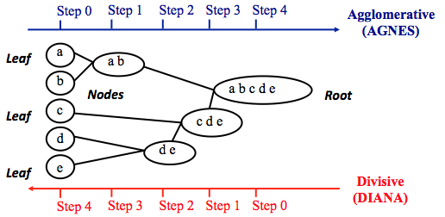

Slide 25
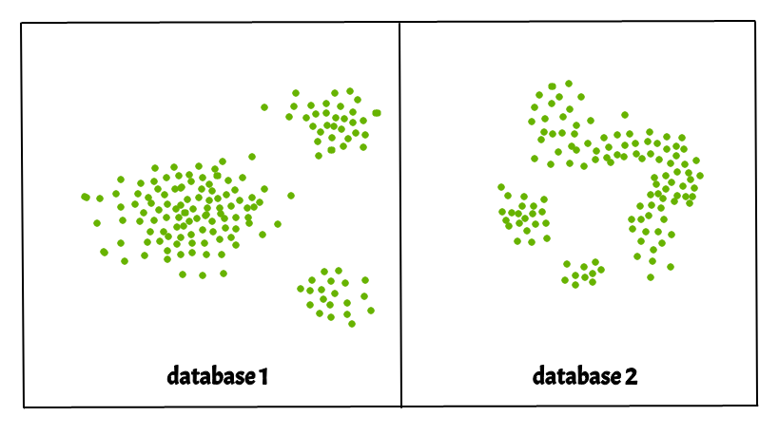
DBSCAN Clustering
Density-based spatial clustering of applications with noise (DBSCAN).
Clusters are dense regions in the data space, separated by regions of the lower density of points.
The DBSCAN algorithm is based on this intuitive notion of “clusters” and “noise”.

Slide 26
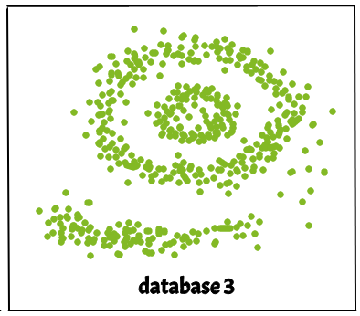
Why DBSCAN?
Partitioning methods (K-means) and hierarchical clustering work for finding spherical-shaped clusters or convex clusters.
In other words, they are suitable only for compact and well-separated clusters.
Moreover, they are also severely affected by the presence of noise and outliers in the data.
Real life data may contain irregularities, like:
Clusters can be of arbitrary shape such as those shown in the figure below.
Data may contain noise.

Slide 27
DBSCAN algorithm requires two parameters:
eps :
It defines the neighborhood around a data point i.e. if the distance between two points is lower or equal to ‘eps’ then they are considered neighbors.
If the eps value is chosen too small then large part of the data will be considered as outliers.
If it is chosen very large then the clusters will merge and the majority of the data points will be in the same clusters.
MinPts:
Minimum number of neighbors (data points) within eps radius. Larger the dataset, the larger value of MinPts must be chosen.
As a general rule, the minimum MinPts can be derived from the number of dimensions D in the dataset as, MinPts >= D+1.
The minimum value of MinPts must be chosen at least 3.

Slide 28
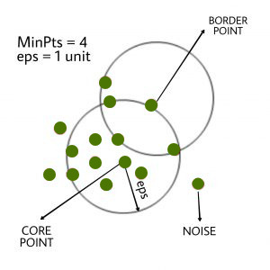
In this algorithm, we have 3 types of data points. Core Point: A point is a core point if it has more than MinPts points within eps. Border Point: A point which has fewer than MinPts within eps but it is in the neighborhood of a core point. Noise or outlier: A point which is not a core point or border point.

Slide 29
What Is Outlier Analysis?
Outlier analysis is the process of identifying outliers, or abnormal observations, in a dataset.
Also known as outlier detection, it’s an important step in data analysis, as it removes erroneous or inaccurate observations which might otherwise skew
There are a wide range of techniques and tools used in outlier analysis.
However, as we’ll see later, it’s often very easy to spot outlying data points conclusions.
Benefits
Outlier analysis only really has one benefit:
it improves the quality of the dataset being subject to analysis.
With a higher-quality dataset, analysts can expect to draw more accurate conclusions (and more of them).

Slide 30
Outlier Analysis Techniques
Sorting
Graphing
Z-score

